Slide 1
Principle Component Analysis
Itay Hazan

Slide 2
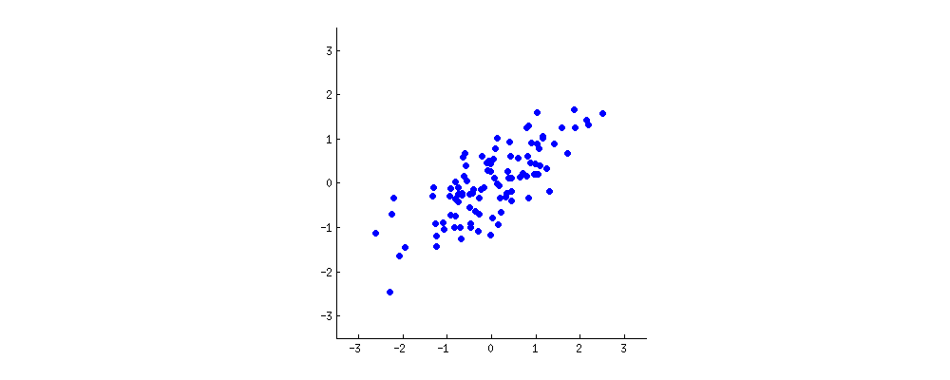
Intuition

Slide 3
Intuition

Slide 4
Intuition

Slide 5
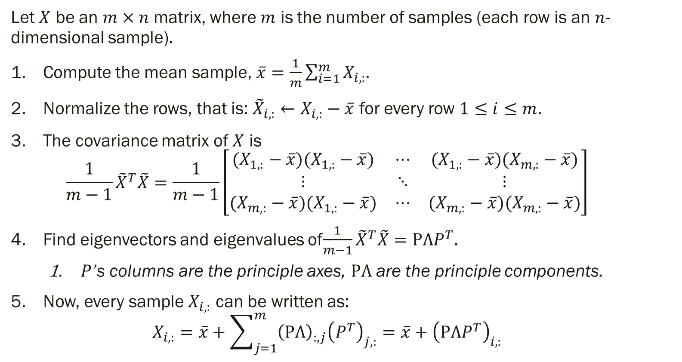
Principle Components Analysis
Let $X$ be an $m×n$ matrix, where $m$ is the number of samples (each row is an $n$-dimensional sample).
Compute the mean sample, $\overline{x}=\frac{1}{m}\sum_{i=1}^{m}{X_{i,:}}$.
Normalize the rows, that is: ${\tilde{X}}_{i,:}←X_{i,:}−\overline{x}$ for every row $1≤i≤m$.
The covariance matrix of $X$ is $\frac{1}{m−1}{\tilde{X}}^{T}\tilde{X}=\frac{1}{m−1}\left[\begin{matrix}(X_{1,:}−\overline{x})(X_{1,:}−\overline{x}) & ⋯ & (X_{1,:}−\overline{x})(X_{m,:}−\overline{x}) \\ ⋮ & ⋱ & ⋮ \\ (X_{m,:}−\overline{x})(X_{1,:}−\overline{x}) & ⋯ & (X_{m,:}−\overline{x})(X_{m,:}−\overline{x})\end{matrix}\right]$
Find eigenvectors and eigenvalues of$\frac{1}{m−1}{\tilde{X}}^{T}\tilde{X}=PΛP^{T}$.
$P$’s columns are the principle axes, $PΛ$ are the principle components.
Now, every sample $X_{i,:}$ can be written as: $X_{i,:}=\overline{x}+\sum_{j=1}^{m}{{\left(PΛ\right)}_{:,j}{\left(P^{T}\right)}_{j,:}}=\overline{x}+{\left(PΛP^{T}\right)}_{i,:}$

Slide 6
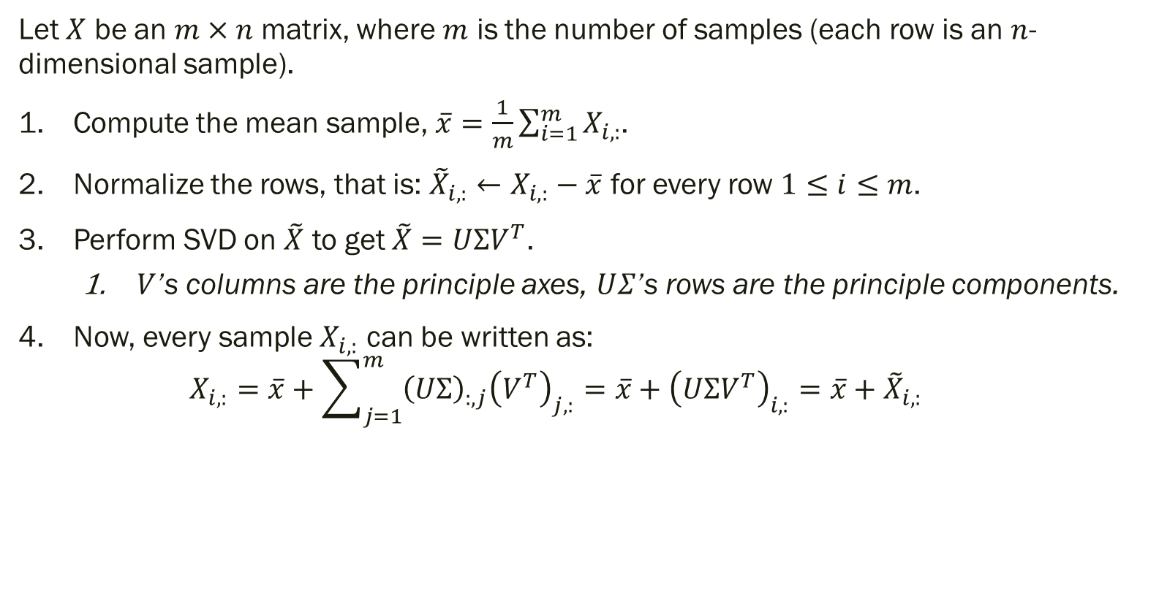
Principle Components Analysis: Better
Let $X$ be an $m×n$ matrix, where $m$ is the number of samples (each row is an $n$-dimensional sample).
Compute the mean sample, $\overline{x}=\frac{1}{m}\sum_{i=1}^{m}{X_{i,:}}$.
Normalize the rows, that is: ${\tilde{X}}_{i,:}←X_{i,:}−\overline{x}$ for every row $1≤i≤m$.
Perform SVD on $\tilde{X}$ to get $\tilde{X}=UΣV^{T}$.
$V$’s columns are the principle axes, $UΣ$’s rows are the principle components.
Now, every sample $X_{i,:}$ can be written as: $X_{i,:}=\overline{x}+\sum_{j=1}^{m}{{\left(UΣ\right)}_{:,j}{\left(V^{T}\right)}_{j,:}}=\overline{x}+{\left(UΣV^{T}\right)}_{i,:}=\overline{x}+{\tilde{X}}_{i,:}$

Slide 7

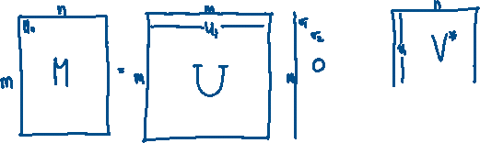







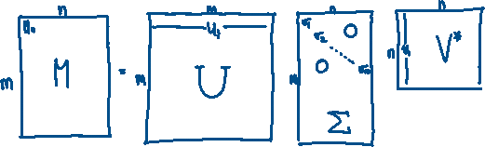














Using SVD for Dimension Reduction

